Slide 1

Target Users (Week 8)
1,000–5,000
AI Writing Assistant
Expected MRR (Week 8)
$500–3K
8-Week Implementation Roadmap: From Concept to Launch
Conversion Target
2–5%

Slide 2


Project Overview
The AI Writing Assistant is a freemium SaaS tool that helps content creators, marketers, bloggers, and students write high-quality content faster using AI. The 8-week roadmap outlines the path from initial planning through beta launch and early growth.
Primary Goals
Launch MVP within 8 weeks
→
Reach 1,000–5,000 free users by Week 8
→
Achieve 2–5% free-to-paid conversion rate by Month 3
→
Generate $500–3,000 MRR by Week 8
→
Success Metrics
Free Users: 1,000–5,000 by Week 8
→
Paid Users: 20–100 by Week 8
→
MRR: $500–3,000 by Week 8
→
Churn Rate: < 10% monthly
→

Slide 3
8-Week Timeline
W1
W2
W3
W4
W5
W6
W7
W8
Foundation & Planning
Development Setup
Core Features
Additional Features
Onboarding & UX
Marketing Setup
Beta Launch
Scaling
Development Phase
Launch & Growth Phase
Week 2: Infrastructure ready
✓
Week 7: Public beta launch
✓
Week 4: MVP features complete
✓
Week 8: Growth optimization
✓
Week 5: Onboarding finalized
✓
Month 2: Feature expansion
✓

Slide 4

Week 1
Foundation & Planning
Goal: Establish project foundation, validate idea, and plan MVP scope.
Key Tasks
Deliverables
Idea validation & market research
→
Competitive analysis document
→
Analyze 5–10 competing AI writing tools
→
MVP feature list
→
MVP feature definition
→
Technical architecture diagram
→
Tech stack selection
→
GitHub repository setup
→
Project setup & documentation
→
Project documentation
→
Success Metrics
Expected Outcome
Competitive analysis completed
→
Foundation established
→
MVP scope clearly defined
→
Team aligned on vision
→
Tech stack validated
→
Clear scope & timeline
→
Project setup completed
→
Ready for development
→
Duration
Team Size
Budget
Users
7 Days
1–2
$2–5K
0

Slide 5
Week 2: Development Setup
Deliverables
Goals
Next.js project with landing page
Set up development environment, initialize databases, and implement user authentication.
→
Supabase database with schema
→
User authentication system
→
Stripe integration with checkout flow
Key Tasks
→
API endpoints for core functionality
→
Frontend setup (Next.js with Tailwind CSS)
→
Backend setup (Vercel Functions + Supabase PostgreSQL)
→
Success Metrics
Database schema creation (users, articles, subscriptions)
→
Landing page live and responsive
✓
User authentication (email/password with Supabase Auth)
→
User authentication working
✓
Database schema created and tested
Payment integration (Stripe setup and checkout)
✓
→
Stripe checkout flow working
✓
All API endpoints functional
✓
Expected Outcome
Complete development infrastructure ready for feature development.

Slide 6


Week 3: Core Feature Development
Article Generation using OpenAI API & LangChain
Goals
Implement core AI article generation feature
→
Integrate OpenAI API and LangChain
→
Build article generation UI
→
Implement usage tracking system
→
Key Tasks
LangChain setup and OpenAI integration
→
Create /api/articles/generate endpoint
→
Build frontend article generation form
→
Implement free tier limits (5 articles/month)
→
Testing and optimization
→
Success Metrics
Output Quality
High-quality articles
API Costs
Within budget
Response Time
< 5 seconds

Slide 7
Week 4: Additional Features
Goals
Expected Outcome
Implement editing, tone control, and summarization features to increase user value and feature completeness.
MVP feature set complete and ready for user testing. All core features working end-to-end with high output quality.
Article Editing
Tone Control
Summarization
Create rich text editor endpoint and UI for users to edit generated articles with formatting options.
Add tone parameter to article generation (professional, casual, creative, technical) with updated prompts.
Implement summarization feature to condense articles into key points using OpenAI API.
API: /api/articles/edit
API: /api/articles/summarize
4 Tone Options
Output Quality
Response Time
Tier Limits
API Costs
High Quality
< 5 seconds
Enforced
On Budget

Slide 8
Week 5: Onboarding & UX
Goals
Deliverables
Create smooth onboarding experience and improve overall UX to drive conversions.
Onboarding flow and tutorial
→
Email marketing sequences
→
Feature showcase page
→
Key Tasks
Pricing comparison table
→
Design onboarding checklist (sign up → verify email → generate article → explore features → upgrade)
→
Conversion optimization elements
→
Analytics tracking setup
→
Create onboarding tutorial (video or interactive walkthrough)
→
Build email sequences (day 1, 3, 7 with tips and guidance)
→
Success Metrics
Create feature showcase page and pricing comparison
→
Implement conversion optimization elements
Onboarding Completion
Feature Understanding
→
> 70%
> 80%
Set up user feedback collection
→
Free-to-Paid Conversion
User Satisfaction
> 2%
> 4/5

Slide 9

Week 6: Marketing & Growth
Goals
Email Marketing
Social & Launch
Establish marketing channels and begin user acquisition through content, email, and social media.
Set up email platform (Mailgun, SendGrid)
→
Create social accounts (Twitter, LinkedIn, TikTok, Instagram)
→
Create email templates
→
Plan content calendar (3–5 posts/week)
Build email list (landing page signup)
→
→
Create social templates
Content Marketing
Plan email sequences
→
→
Publish first 5 posts
Onboarding (day 1, 3, 7)
→
Create blog (5–10 initial articles)
→
→
Create Product Hunt listing
Feature tips & upsell
→
Set up SEO (keyword research, meta tags)
→
→
Reach out to influencers
Create YouTube channel
→
→
Publish first 3 blog posts
Success Metrics
→
Success Metrics
Publish first 2 YouTube videos
→
Email List
100+
Social Followers
Success Metrics
100+
Blog Posts
Templates
5+
5+
Launch Traffic
500+
YouTube Videos
2+

Slide 10

Week 7
Beta Launch & Early User Acquisition
Goal: Launch to beta users, gather feedback, and begin organic user acquisition.
Content Marketing
Success Metrics
Publish 2–3 new blog posts
→
Signups (Week 7)
Publish 1–2 new YouTube videos
→
500+
Key Tasks
Share content on social media
→
Engage with community comments
Launch to Product Hunt (if applicable)
→
→
Paid Conversions
Send launch announcement email
10+
→
Post on social media channels
Deliverables
→
Beta launch completed
Conversion Rate
Reach out to beta testers
→
→
> 2%
Feedback gathered and prioritized
Monitor feedback and support
→
→
Bug fixes implemented
Gather user feedback
→
→
User Feedback
Content marketing in progress
Identify critical bugs
→
→
4+/5
Growth metrics tracked
Prioritize fixes and improvements
→
→
Product Hunt
Top 10

Slide 11


Week 8
Scaling & Optimization
Goal: Scale user acquisition with paid ads and optimize conversion funnel for maximum revenue.
Success Metrics (Week 8)
Key Tasks
Total Signups
1,000–5,000
Set up Google Ads (search and display campaigns)
→
Create ad copy and landing pages
Paid Users
→
Optimize conversion funnel (landing page → signup → trial → paid)
20–100
→
A/B test pricing and features
→
MRR
Implement influencer partnerships
→
$500–3K
Plan Month 2 initiatives
→
Analyze metrics and ROI
→
Conversion Rate
2–5%
Deliverables
Google Ads campaigns live
→
Optimized conversion funnel
→
A/B test results
→
Influencer partnerships established
→
Month 2 growth plan
→

Slide 12

Expected Outcomes by Week
Metric
Week 1
Week 2
Week 3
Week 4
Week 5
Week 6
Week 7
Week 8
Free Signups
0
0
50
100
200
400
500+
1–5K
Paid Users
0
0
0
0
0
2–3
10+
20–100
MRR
$0
$0
$0
$0
$0
$10–30
$50–300
$500–3K
Conversion Rate
—
—
—
—
—
0.5–0.8%
2%
2–5%
Blog Traffic
0
0
0
0
50
100–200
200–300
300–500
Social Followers
0
0
0
0
0
100–200
200–500
500–1K
Email List
0
0
0
0
50
100–150
150–300
300–500
Churn Rate
—
—
—
—
—
—
15%
<10%
Key Assumptions:
• Free tier limited to 5 articles/month; paid tier ($9–29/month) offers unlimited articles with advanced features
• Conversion rate improves as onboarding and marketing mature (Week 6–8)
• MRR assumes average paid user value of $15–25/month
• Churn rate improves with better onboarding and customer success (target <10% by Month 2)

Slide 13

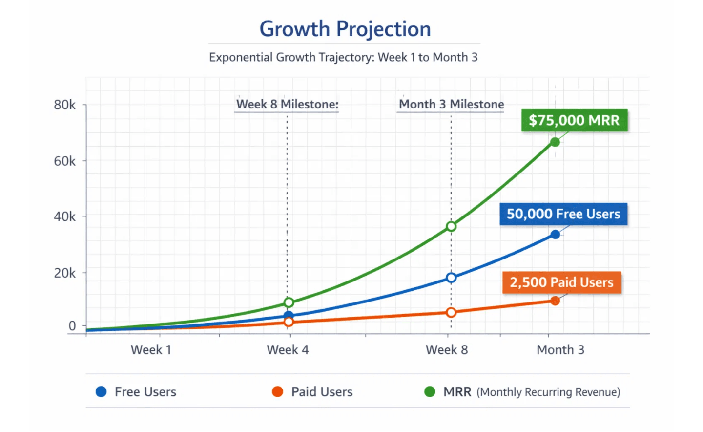
Growth Trajectory
The AI Writing Assistant is projected to experience exponential growth from Week 1 through Week 8, driven by organic user acquisition, content marketing, and paid advertising efforts.
Week 1–4: Foundation Phase
Development and infrastructure setup
→
Minimal user acquisition (0–100 users)
→
Focus on product quality and feature completion
→
Week 5–6: Launch Preparation
Marketing channels established
→
User acquisition begins (100–500 users)
→
Content marketing in progress
→
Week 7–8: Scaling Phase
Beta launch and public availability
→
Exponential growth (500–5,000 users)
→
Paid advertising and organic channels active
→
Revenue generation begins ($500–3,000 MRR)
→
Week 8 Users
Week 8 MRR
1–5K
$500–3K

Slide 14

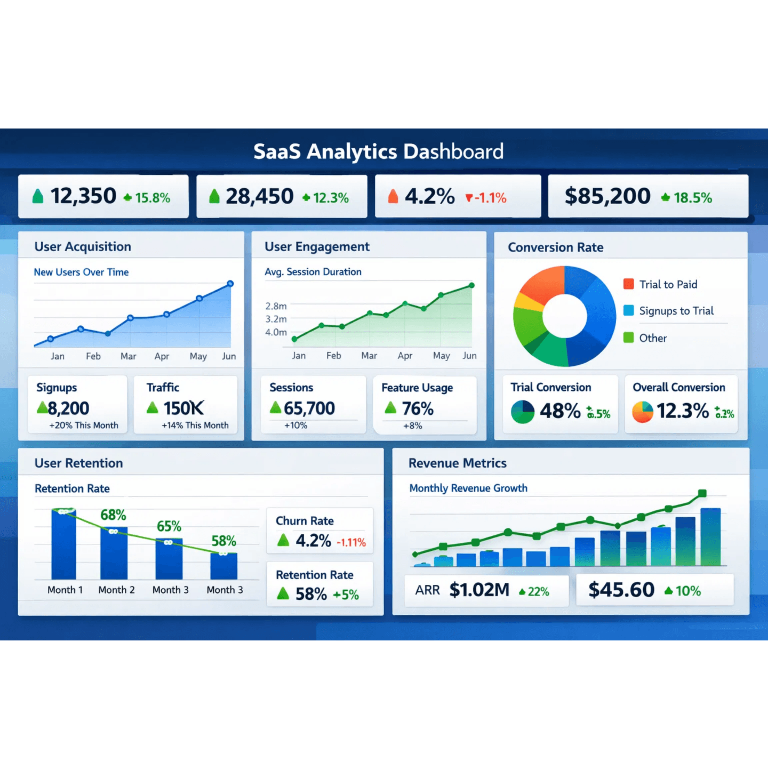
Critical Metrics to Track
User Acquisition
Engagement
Signups (Weekly)
Active Users (DAU/MAU)
100–500
30–50%
CAC (Cost per Acquisition)
Articles Generated
< $5
5–20 per user
Traffic Sources
Session Duration
Organic, Paid, Referral
> 5 min
Conversion
Retention & Revenue
Free-to-Paid Conversion
Monthly Churn Rate
2–5%
< 10%
Paid Signups (Weekly)
MRR (Monthly Recurring Revenue)
2–25
$500–3K
Conversion Rate Trend
LTV (Lifetime Value)
Increasing ↑
> $100

Slide 15
Technology Stack
Frontend
Backend
AI & ML
Tools & Services
Core Framework
Serverless
LLM Integration
Payments
Next.js 14+
•
Vercel Functions
•
OpenAI API
•
Stripe API
•
React 19+
•
Node.js Runtime
•
GPT-4 Turbo
•
Webhook Handling
•
TypeScript
•
LangChain
Database
•
Email
Supabase PostgreSQL
•
SendGrid
Styling
Prompt Engineering
•
Tailwind CSS
•
Prisma ORM
•
Custom Prompts
•
Email Templates
•
CSS Modules
•
Temperature Control
Authentication
•
Version Control
Token Optimization
Supabase Auth
•
•
GitHub
State & Routing
•
React Hooks
•
JWT Tokens
•
Git Workflows
Embeddings
•
Next.js Router
•
OpenAI Embeddings
API
•
Monitoring
Vector Storage
REST API
•
•
Vercel Analytics
Hosting
•
Vercel
API Routes
•
Error Tracking
AI Provider
•
Database
OpenAI
CI/CD
PostgreSQL
GitHub + Vercel

Slide 16
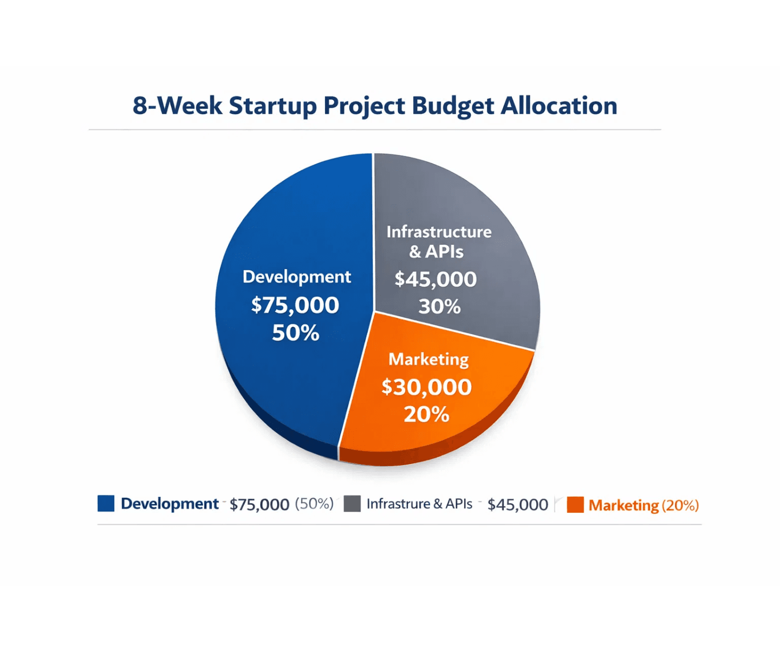
Budget & Resources
$25–50K
ROI Projections
Total 8-Week Budget
Week 8 Revenue
Month 3 Revenue
Payback Period
Budget Allocation
$500–3K MRR
3–6 months
$5–75K MRR
Development (Salaries)
$12–20K
(48–50%)
Infrastructure & Tools
$3–5K
(12–20%)
Marketing & Acquisition
$8–20K
(32–40%)
Contingency (10%)
$2–5K
(8–10%)
Resource Requirements
1–2 Full-time Developers (Full Stack)
→
1 Part-time Product Manager / Marketer
→
1 Part-time Designer (UI/UX)
→
Cloud infrastructure (Vercel, Supabase)
→
API costs (OpenAI, Stripe, SendGrid)
→

Slide 17

Risk Mitigation
High Impact
High Impact
Medium Impact
1. High API Costs
2. High Churn Rate
3. Low Conversion Rate
OpenAI API costs could exceed budget if usage is higher than projected, reducing profitability.
Users may cancel subscriptions if they don't see value or if the product doesn't meet expectations.
Free-to-paid conversion may be lower than projected, impacting revenue targets.
Mitigation Strategies:
Mitigation Strategies:
Mitigation Strategies:
Implement usage limits and tier-based pricing to control costs
✓
Implement strong onboarding with tutorials and walkthroughs
✓
A/B test pricing, features, and messaging to optimize conversion
✓
Optimize prompts to reduce token usage and API calls
✓
Collect user feedback weekly and iterate on features
✓
Implement feature limits on free tier to encourage upgrades
✓
Monitor API costs daily and set budget alerts
✓
Create email sequences to re-engage inactive users
✓
Create comparison pages and case studies showing ROI
✓
Medium Impact
Medium Impact
4. Competitive Pressure
5. Regulatory Issues
Established competitors may lower prices or improve features, reducing market share.
AI regulations or copyright concerns may impact product availability or require compliance changes.
Mitigation Strategies:
Mitigation Strategies:
Focus on niche markets (specific industries or use cases)
✓
Monitor AI regulation updates and compliance requirements
✓
Build unique features competitors don't have (integrations, templates)
✓
Add copyright disclaimers and user responsibility clauses
✓
Maintain fast iteration cycle to stay ahead of competition
✓
Implement content moderation to prevent misuse
✓

Slide 18
8 Critical Success Factors
Factor 1
Factor 5
Product Quality
Email Marketing
Build high-quality, reliable features that generate excellent article content. User satisfaction directly impacts retention and referrals.
Build an engaged email list and execute targeted email sequences for onboarding, feature education, and upselling to drive conversions and retention.
Factor 2
Factor 6
Fast Iteration
Community Building
Ship features quickly and iterate based on user feedback. Weekly releases and rapid experimentation accelerate learning and product-market fit.
Engage with users on social media, respond to feedback, and build a community around the product. Word-of-mouth and referrals drive sustainable growth.
Factor 3
Factor 7
Conversion Optimization
Customer Success
Continuously optimize the free-to-paid conversion funnel through A/B testing, pricing experiments, and feature positioning to maximize revenue.
Provide excellent onboarding, support, and customer success to reduce churn and increase lifetime value. Happy customers become advocates and referral sources.
Factor 4
Factor 8
Content Marketing
Data-Driven Decisions
Create valuable blog posts, YouTube videos, and social media content that drive organic traffic and establish thought leadership in the AI writing space.
Track metrics obsessively (signups, conversions, churn, MRR) and make decisions based on data. Measure everything and optimize ruthlessly.

Slide 19

Beyond Week 8: Month 2–3 Growth Plan
Primary Goals
Month 3 Initiatives
Expand feature set, accelerate user acquisition, optimize monetization, and establish enterprise strategy.
Enterprise Strategy
→
Develop enterprise pricing and features
•
Create API for third-party integrations
•
Month 2 Initiatives
Launch team collaboration features
•
Advanced Analytics
Advanced Features Development
→
→
Implement comprehensive usage analytics
AI-powered article editing and refinement
•
•
Build ROI calculator for users
Multi-language support (Spanish, French, German)
•
•
Create performance dashboards
Custom tone and style profiles
•
•
Strategic Partnerships
Marketing Expansion
→
→
Partner with content platforms (Medium, Substack)
Expand paid advertising (Google Ads, Facebook Ads)
•
•
Integrate with productivity tools (Notion, Zapier)
Launch affiliate program
•
•
Explore acquisition opportunities
Partner with content creators and influencers
•
•
Customer Success
→
Expected Outcomes (Month 3)
Implement customer support system (Intercom, Zendesk)
•
Create user onboarding videos
•
Free Users
Paid Users
Launch community (Discord, Slack)
10,000–50,000
200–2,500
•
MRR
Churn Rate
$5,000–75,000
< 8%

Slide 20
Summary & Next Steps
Roadmap Summary
Immediate Next Steps (Week 1)
The 8-week implementation roadmap provides a structured path to launch the AI Writing Assistant from concept to market. The plan balances rapid development with strategic marketing to achieve sustainable growth.
Finalize project scope and MVP feature list
→
Conduct competitive analysis (5–10 tools)
→
Select and validate tech stack
→
Create project documentation and architecture
Phase 1: Foundation (Weeks 1–2)
→
Set up GitHub repository and development environment
Planning & Infrastructure
→
Phase 2: Development (Weeks 3–5)
Critical Success Factors
Core Features & UX
Product quality and feature completeness
→
Fast iteration and rapid deployment
→
Phase 3: Launch & Growth (Weeks 6–8)
Effective conversion funnel optimization
→
Marketing & Scaling
Consistent content marketing execution
→
Email marketing and user engagement
→
Expected Outcomes (Week 8)
Community building and organic growth
→
Free Users
1,000–5,000
Conversion Rate
2–5%

Slide 21
Questions & Discussion
Let's discuss the roadmap, challenges, and opportunities ahead.
Strategic Questions
Financial & Growth Questions
What is our primary target market and user persona?
?
Are the revenue projections realistic and achievable?
?
How do we differentiate from established competitors like Jasper and Copy.ai?
?
What is our customer acquisition cost (CAC) target?
?
How do we achieve the projected conversion rates?
?
What is our long-term vision beyond Month 3?
?
What is our pricing strategy and willingness to adjust?
?
Should we focus on B2B, B2C, or both?
?
Operational Questions
Technical Questions
Do we have the right team and resources in place?
?
Are we confident in the tech stack choices (Next.js, Supabase, OpenAI)?
?
What are the biggest risks and how do we mitigate them?
?
How do we measure success and adjust the plan?
What are the infrastructure scalability limits?
?
?
What is our decision-making framework for pivots?
How do we handle API rate limiting and cost control?
?
?
What are the data privacy and security considerations?
?
Ready to Discuss?
Share your thoughts — your feedback will shape our execution.

Slide 22
Contact & Resources
Everything you need to get started and stay connected.
Contact Information
Documentation & Resources
Tools & Platforms
Project Lead
Product Roadmap — 8-week implementation plan and milestones
→
Frontend
AI & APIs
team@aiwritingassistant.com
Next.js 14+ (React framework)
•
OpenAI GPT-4 Turbo (LLM)
•
Technical Architecture — System design and technology stack details
Technical Support
→
LangChain (prompt engineering)
support@aiwritingassistant.com
•
TypeScript (type safety)
API Documentation — Integration guides and endpoint references
•
Sales & Partnerships
→
sales@aiwritingassistant.com
Tailwind CSS (styling)
•
Stripe (payments)
User Guide — Feature walkthrough and best practices
•
Website
→
www.aiwritingassistant.com
FAQ & Troubleshooting — Common questions and solutions
Backend & Database
Deployment & Monitoring
GitHub Repository
→
github.com/aiwritingassistant
Vercel Functions (serverless)
•
Vercel (hosting & CI/CD)
Blog & Tutorials — Content marketing and educational resources
•
→
For urgent inquiries, reach out to the project lead directly. Response time: 24 hours.
Supabase PostgreSQL (database)
•
GitHub (version control)
Community Forum — User discussions and peer support
•
→
SendGrid (email)
All documentation is maintained and updated weekly. Check the GitHub wiki for the latest versions.
•
Prisma ORM (data access)
•
For detailed setup instructions and configuration guides, refer to the technical documentation.

